Slide 1
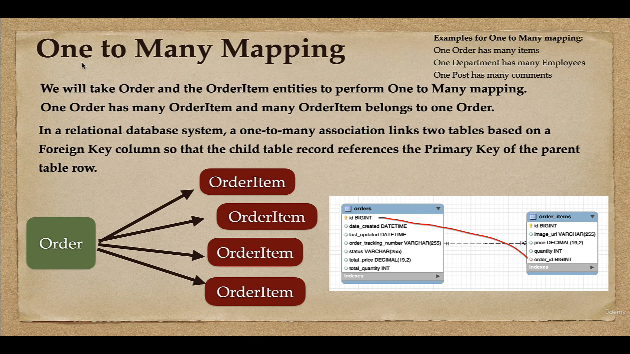

Slide 2
One To Many Mapping Types
Unidirectional one to many association
Bidirectional one to many association
The unidirectional @OneToMany association is simpler since it’s just the parent-side that defines the relationship.
In Unidirectional mapping, we use only @OneToMany annotation
The bidirectional association requires the child entity mapping to provide a @ManyToOne annotation, which is responsible for controlling the association.
In bidirectional mapping, we use both @OneToMany and @ManyToOne annotations.

Slide 3
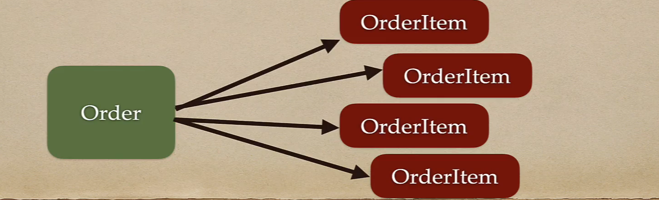
One to Many Unidirectional Mapping
One Order has many order items
Save Order will also save associated order items (using Cascade.PERSIST)
Update Order will also update associated order items (using Cascade.MERGE)
Delete Order will also delete associated order items (using Cascade.REMOVE)

Slide 4
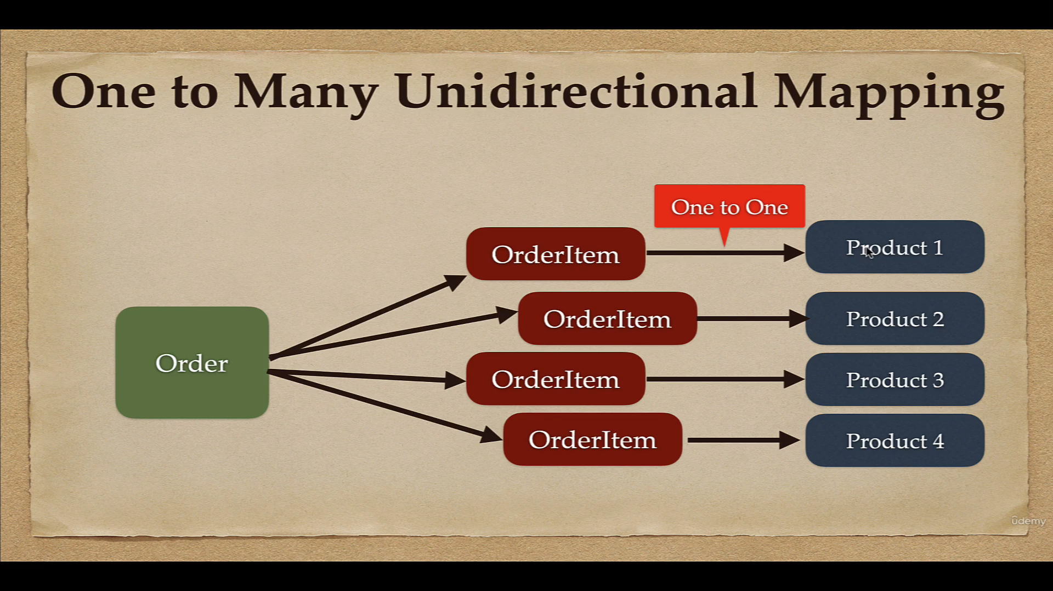

Slide 5
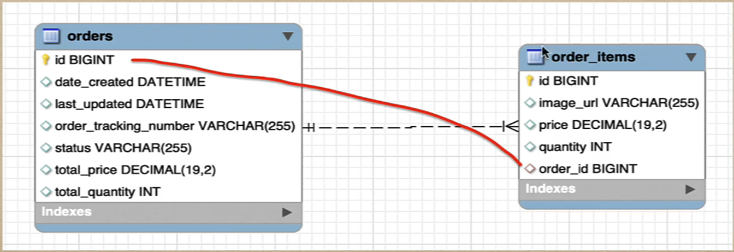
One to Many Unidirectional Mapping
In a relational database system, a one-to-many association links two table based one Foreign Key column so that the child table record references the Primary Key of the parent table row.

Slide 6
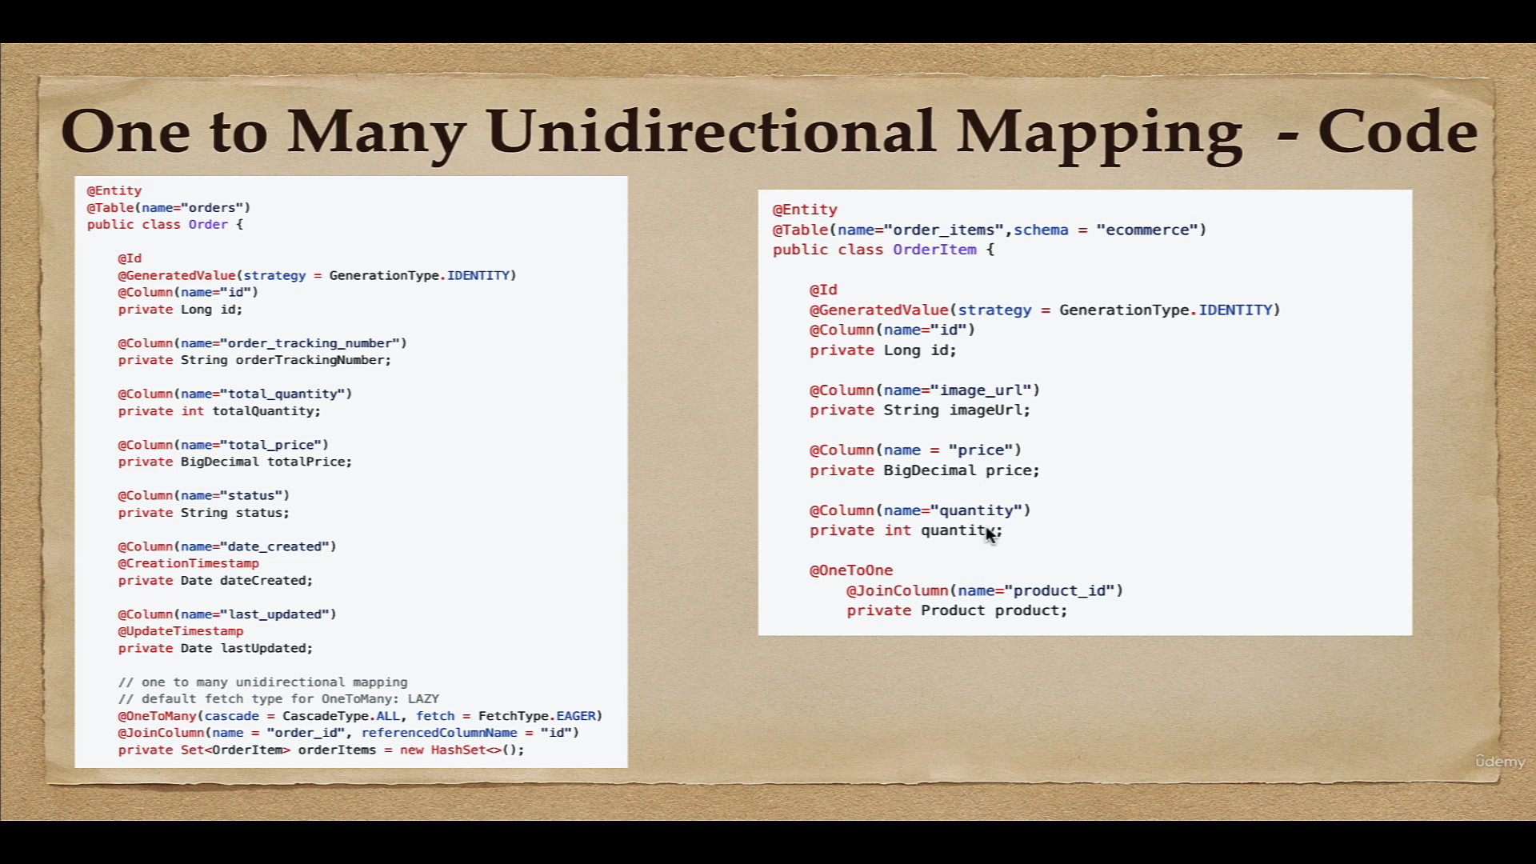

Slide 7
Fetch Types – Eager vs Lazy
Eager means it will retrieve everything
Lazy means it will retrieve on request or on demand

Slide 8
Default Fetch Types for Mappings
From the JPA 2.0 spec, the defaults are:
OneToMany: LAZY
ManyToOne: EAGER
ManyToMany: LAZY
OneToOne: EAGER

Slide 9
One to Many Bidirectional Mapping
One Order has many order items and many order items belongs to a one order.
In bidirectional mapping, we use both @OneToMany and @ManyToOne JPA annotations.

Slide 10
One to Many Bidirectional Mapping

Slide 11
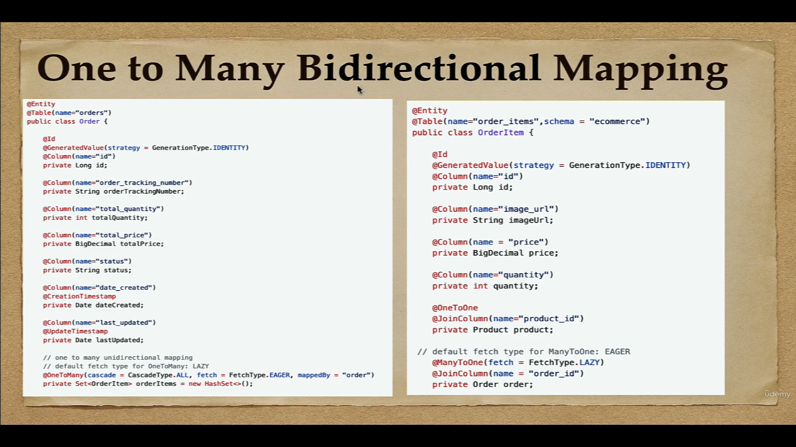

Slide 12
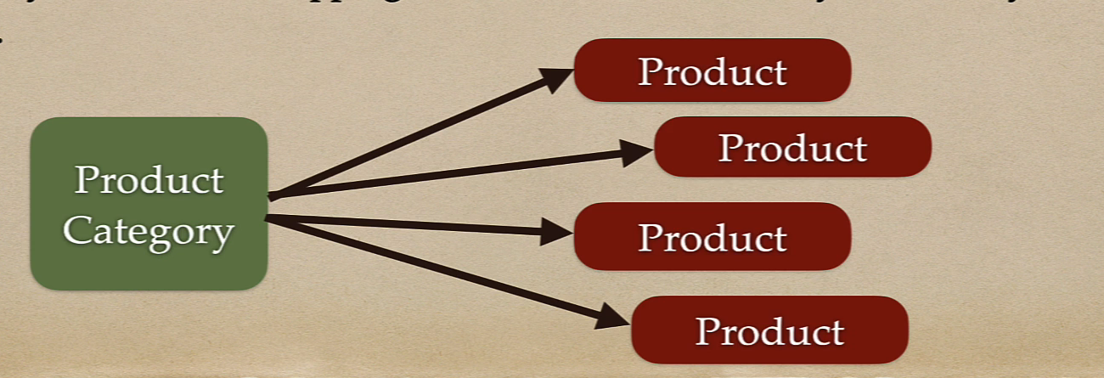
One To Many Mapping
In our e-ecommerce project, we will implement one more one to many mapping.
One ProductCategory has many Product and many Product belongs to one ProductCategory.
In this example, we implement one-to-many bidirectional mapping between ProductCategory and Product entities.
In one to many bidirectional mapping, we use both @OneToMany and @ManyToOne JPA annotations.

